Slide 1
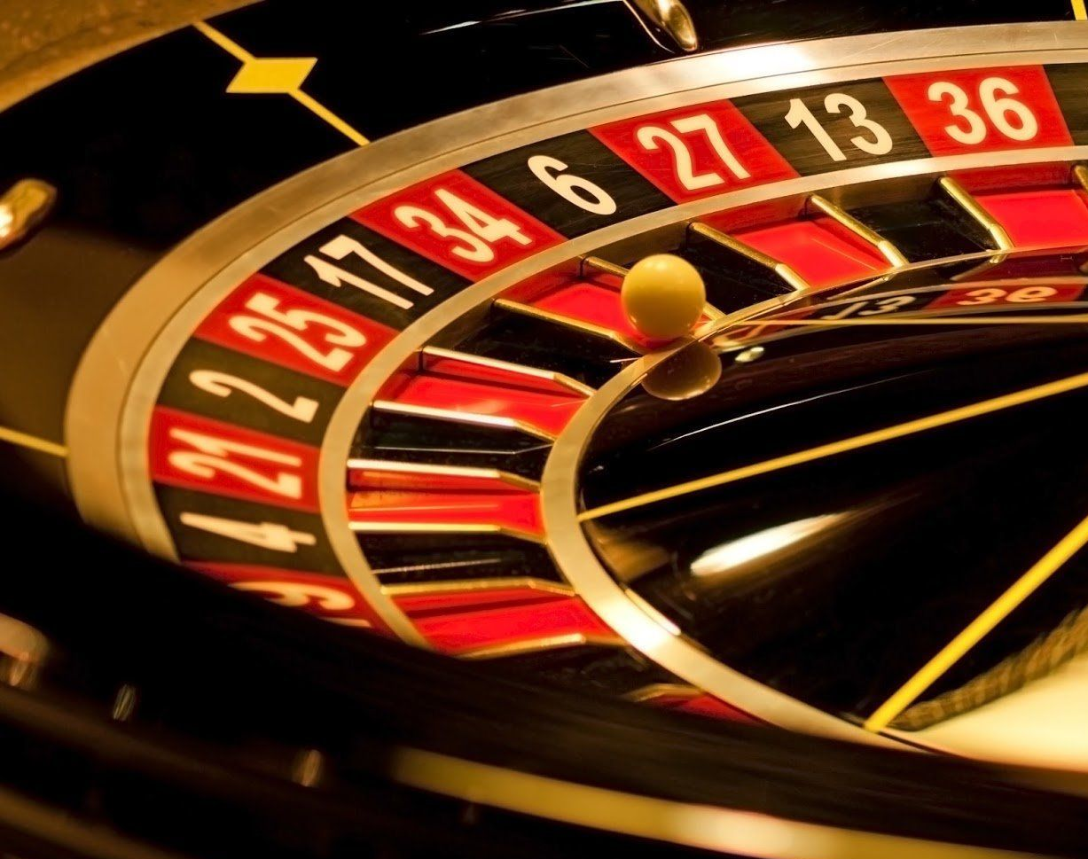
Monte Carlo Simulation of American Roulette in R
Matthew Wechsler
4/10/2020

Slide 2
Abstract – What did I do in a Nutshell
I decided to create a roulette wheel simulation using R. I created a simulation of 100 spins of a roulette wheel where I bet the same thing all 100 times. I repeated that test 10,000 times to create a Monte Carlo Simulation and repeated this multiple times with different bets to see the outcomes.

Slide 3
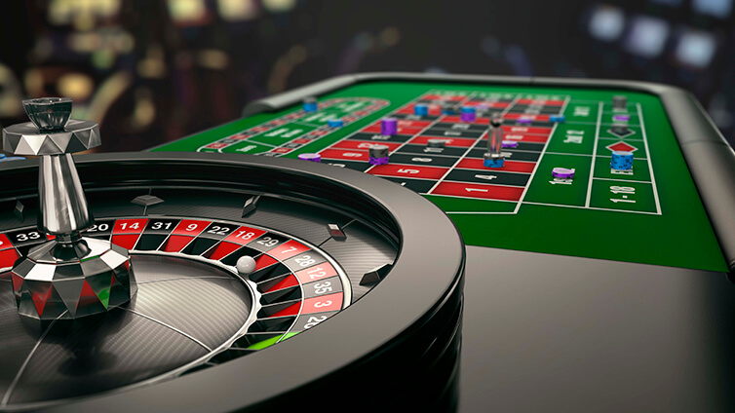
Introduction
I decided to choose this topic because I recently went to a casino and played roulette for a few hours (even though it only felt like 5 minutes). At first, I was only betting on red or black. I was betting very small amounts (somewhere between $1 and $3 every time) so I got very bored very fast because I was not making money quickly. Because of this I decided to start betting on specific numbers. I got extremely lucky and my number hit 3 times in 20 spins. I began to wonder what the odds of that were and what I would win if I sat at that table 8 hours a day playing that number. I also wondered what the optimal bet was to win as much money as possible. Because of this, I decided to put the American Roulette wheel into R and try to answer some of my questions.

Slide 4
Monte Carlo Procedure
Procedure:
1. Describe the experiment and all of its possible outcomes
2. Characterize the probabilities associated with each outcome
3. Match these probabilities up with what is produced by some random number generator
4. Generate a large number of random experiments according to this rule
Procedure
I gave each experiment 2 outcomes, win and lose
I gave each of those outcomes a probability. The probability changed depending on what I was testing
I created a simulation of 100 spins and took the total winnings of those 100 spins
I repeated those 100 spins 10,000 times

Slide 5
How did I solve the problem?
I found it very hard to find actual data on specific spins on a real roulette wheel at a casino. I am not sure if they keep track of every spin or if they release that data to the public. Because of this, I decided to create my own data. I created an American Roulette Wheel simulation in R. The simulation spun the wheel 100 times and gives back the total winnings. So for example, when I ran the simulation on betting a specific number, if that number did not hit once in the 100 spins, the simulation would show -$100. If it hit 10 times and lost it would show $260. The simulation spun the wheel 100 times for 10,000 trials which totals to 1,000,000 spins.

Slide 6
How did I solve the problem?
I decided to test multiple bets because I wanted to find out which of them was the best. The first one I tested was betting black or red. The probability of winning this on an American wheel is 18/38(.474). If the wheel lands on red, you win $1. Next, I tested betting green. The probability of landing on green in 2/38(.052) and if it lands on green, you win $18. Next, I tested betting on a single number. The probability of winning this is 1/38(.026) and if it lands on your number, you win $35. Lastly, I tested betting on two things at once; red or black and even or odd. I hypothesized that this would be the best chance to win because you have 27 chances to win.

Slide 7
R Code Used
set.seed(12543)
p_win <- 1/38 #Edited for probability of each bet#
p_lose <- 37/38
n <- 100
B <- 10000
test <- replicate(B,{
X <- sample (c(35,-1), size = n, replace = TRUE, prob = c(p_win, p_lose))
sum(X)
}) #edited for winnings of each bet in c(#, #)#
mean(test)
sd(test)
hist(test)
stem(test)

Slide 8
What did I find out
Firstly, I found out Roulette is not a good game to play if you are trying to make money. All of the bets averaged negative returns though all of them did show very large standard deviations which shows the opportunity for great returns. All of the tests were around -$5 for average returns but all had very large standard deviations.
Bet | Mean | Standard Deviation
Color | -$5.23 | $10.05
Number | -$5.44 | $57.49
Green | -$4.42 | $40.20
Number + Even | -$33.70 | $12.91

Slide 9
Histograms
Color
Number

Slide 10
Histograms
Green
Color and Even

Slide 11
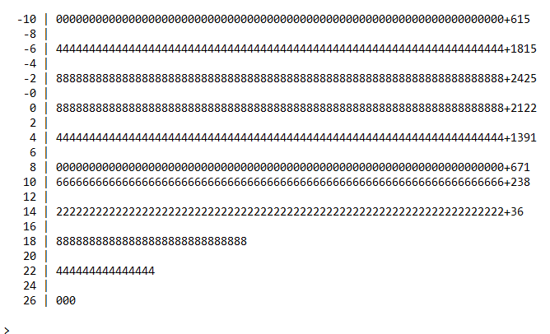
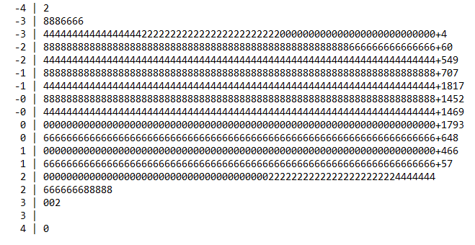
Stem and Leaf Plots
Color
Number

Slide 12
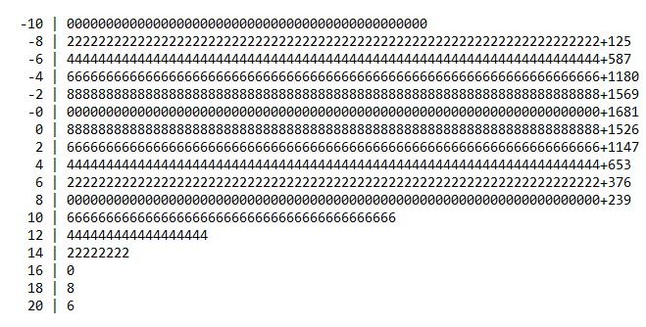
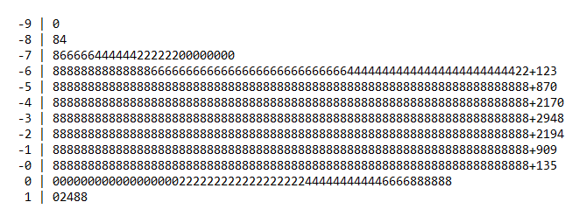
Stem and Leaf Plots
Green
Color and Even

Slide 13
Discussion
After running all of the tests and examining the data I was first disappointed that none of them came out to give out positive returns. I was also very surprised that betting a color and even was the worst bet by far. After examining the data, betting on a single number seems like the bet with the most upside if you are going to be at the table for a while. It is not a good bet if you are not playing for long because as seen in the stem and leaf plot, there were over 600 times that the single number was not pulled at all and there was a return of -$100.

Slide 14
Discussion
In conclusion I found that roulette is not a safe game to play because of the average negative returns it gives. There is however a chance for great returns if luck is in your hand. If I was going to play I would choose what to bet on based on the amount of time I was planning on playing. If I was only playing for a short time I would bet on a color because it comes with the least risk as most of the time you either lose a small amount or win a small amount. If I was planning on playing for a long time, I would bet on either a single number or green. I would now be aware however that if I am going to win, it can take a long time and once you win, you should get out because odds are you will not win again for a long time.

Slide 15
Work that helped me
I used a Harvard online lesson to help me come up with the code to make the simulation in R. That lesson can be found here:
https://campus.datacamp.com/courses/harvardx-data-science-probability-ph1253x/24242?ex=2
I used our classes Monte Carlo lessons that can be found here:
https://rutgers.instructure.com/courses/39556/files/7987990?module_item_id=2199891

